Slide 1
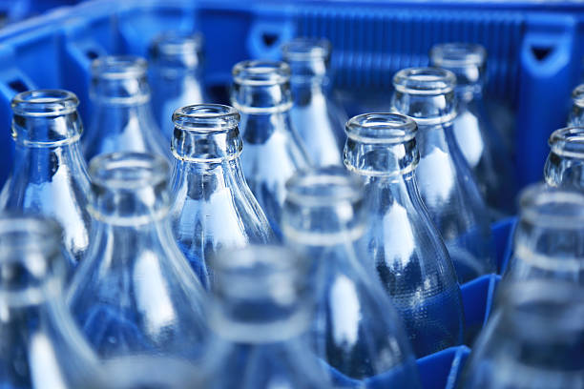
Leatherhead Food Research
Returnable glass and PET bottles
The Coca-Cola Company
2nd November 2022 (updated 6th December 2022)
Confidential information

Slide 2
Returnable Glass Bottles (priority markets)
 | Are returnable glass bottles permitted? | Has competitor activity been identified?
Argentina | Permitted | Yes (AB InBev, Heineken and non-competitors)
Brazil | Permitted | Yes (AB InBev and non-competitors)
Chile | Permitted | Yes (Heineken, AB InBev and non-competitors)
Colombia | Permitted | Yes (AB InBev and non-competitors)
India | Permitted | Yes (AB InBev, Heineken, PepsiCo and non-competitors
Mexico | Permitted | Yes (AB InBev, Heineken, PepsiCo and non-competitors)
Pakistan | Permitted | Yes (PepsiCo)
Philippines | Permitted | No (large national non-competitor activities identified)
Turkey | Permitted | No (large national non-competitor activities identified)
United States | Permitted | Yes (PepsiCo, AB InBev Heineken and non-competitors)
EU (General) | Permitted | N/A
France | Permitted | Yes (PepsiCo, Heineken, Danone, AB InBev, Nestle and non-competitors)
Germany | Permitted | Yes (PepsiCo, Heineken, Danone, AB InBev, Nestle and non-competitors)
Italy | Permitted | Yes (Heineken and non-competitors)
Spain | Permitted | Yes (PepsiCo, Heineken, Danone and non-competitors)

Slide 3
Returnable PET Bottles (priority markets)
 | Are returnable PET bottles permitted? | Has competitor activity been identified? | Comments
Argentina | Permitted | No* | The Argentinian government is working on the development of a packaging law, which may include a tax (single use plastic tax) for those companies using non-recyclable plastics with the purpose of encouraging the use of returnable and/or recyclable packaging
Brazil | Permitted | No*
Chile | Permitted | Maybe | From 13 February 2023 consumers must be able to give back empty returnable plastic bottles to supermarkets; the Regulation to the Law will determine the percentage of returnable format bottles available for sale that supermarkets must offer but this has not yet been published One PepsiCo product is labelled as returnable, however, unable to confirm if these bottles from PepsiCo are returned and refilled or recycled
Colombia | Permitted | No*
India | Not permitted | No
Mexico | Permitted | No*
Pakistan | Not permitted | No
Philippines | Permitted | No | Extended Producer Responsibility Act of 2022, enacted in July 2022 The EPR programme provides tax incentives following an approval process; however, details are not yet available
Turkey | Not permitted | No
USA | Unclear | No | The Break Free From Plastic Pollution Act of 2021 was introduced but has not passed either the House or the Senate and it remains to be seen whether it will progress. If passed, the bill would expand support for reuse and refill technology
EU (General) | Not specifically regulated | N/A | Proposal to set a 75% reuse target for drinks packaging by 2040 and 20% by 2030 is about to be published, therefore it is likely that returnable PET bottles will be permitted in all Member States
France | Permitted | No | Tests are being carried out for standardised returnable bottles to increase returnable bottles
Germany | Permitted | Yes (PepsiCo, Unilever, Nestle, Danone and non-competitors) | Returnable bottles are common practice
Italy | Unclear | No | A campaign to launch a Deposit scheme for plastic bottles has been launched Italian Plastic Tax deferred to 1 January 2024 appliable to PET bottles
Spain | Permitted | No | Upcoming plastic tax to enter into force in January 2023 A Draft Decree to be approved within 6 month, sets reuse targets for beverage packaging – assuming all materials in scope including glass and PET
*TCCC product identified

Slide 4
Returnable Glass Bottles (remaining markets 1/2)
 | Are returnable glass bottles permitted? | Has competitor activity been identified?
Algeria | Permitted | No
Australia | Not possible | No
Belgium | Permitted | Yes (AB InBev, PepsiCo, Heineken and non-competitors)
Bolivia | Permitted | No (large national non-competitors activities identified)
Canada | Permitted | Yes (non-competitors activities identified)
China | Permitted | No (small non-competitor activities identified)
Ecuador | Permitted | No (large national non-competitor activities identified)
Egypt | Permitted | No (large national non-competitor activities identified)
Indonesia | Permitted | Yes (Danone)
Japan | Permitted | Yes (AB InBev, PepsiCo, Heineken and non-competitors)
Kazakhstan | Permitted | No (large national non-competitor activities identified)
Kenya | Permitted | No (large national non-competitor activities identified)
Morocco | Permitted | No

Slide 5
Returnable Glass Bottles (remaining markets 1/2)
 | Are returnable glass bottles permitted? | Has competitor activity been identified?
Netherlands | Permitted | Yes (AB InBev, Heineken and non-competitors)
Nigeria | Permitted | Yes (AB InBev, Heineken and non-competitors)
Peru | Permitted | Yes (SABMiller and other large national and non-competitors)
Poland | Permitted | Yes (AB InBev, Heineken and non-competitors)
Romania | Permitted | No (large national non-competitor activities identified)
Russia | Permitted | No
Saudi Arabia | Permitted (not permitted for soda lime glass bottle for carbonated beverages up to 1L) | No (non-competitor activities identified)
South Africa | Permitted | Yes (PepsiCo, Heineken and non-competitors)
South Korea | Permitted | Yes (AB InBev and large national non-competitors)
Thailand | Permitted | No (non-competitor activities identified)
UK | Permitted | No (non-competitor activities identified)
Vietnam | Permitted | Yes (Heineken, PepsiCo and non-competitors)

Slide 6
Returnable PET Bottles (Remaining markets 1/2)
 | Are returnable PET bottles permitted? | Has competitor activity been identified? | Comments
Algeria | Unclear | No
Australia | Not possible | No | Target 1 of the ANZPAC Plastics Pact (ANZPAC) is to eliminate unnecessary and problematic plastic packaging through redesign, innovation and alternative (reuse) delivery models
Belgium | Unclear | No | Regional pilot deposit scheme established In 2020, the government published a coalition agreement which "includes the possibility to incorporate a deposit return scheme in the packaging tax during this legislature”
Bolivia | Permitted | No*
Canada | Unclear | No
China | Unclear | No
Ecuador | Unclear | No
Egypt | Permitted | No | New regulation has just been published
Indonesia | Permitted | No | In 2020, the Indonesia Packaging Recovery Organization (IPRO) was set up to increase the collection and recycling of used packaging Circular economy platform Octopus Waste management PTE. Ltd was formed in 2022. Octopus helps producers to: 1. track and collect their post-consumer product, and 2. give incentives directly to verified stakeholders
Japan | Not recommended | No
Kazakhstan | Not permitted | No
Kenya | Unclear | No
*TCCC product identified

Slide 7
Returnable PET Bottles (Remaining markets 2/2)
 | Are returnable PET bottles permitted? | Has competitor activity been identified? | Comments
Morocco | Unclear | No
Netherlands | Permitted | No | Decision has been taken to make the reuse of plastic packing common and scale up over phases Published a report about the possibilities to introduce national tax on virgin plastic
Nigeria | Unclear | No
Peru | Permitted | No*
Poland | Unclear | No | Introduced a national deposit scheme for glass and plastic bottles. Target to reuse 90% bottles
Romania | Permitted | No | From 30 November 2023, a mandatory national deposit scheme for beverage packaging will be introduced
Russia | Unclear | No
Saudi Arabia | Not permitted | No
South Africa | Permitted | No* | The SA Plastic Pact was introduced in January 2020 and the roadmap sets a targets on refill or reuse activity
South Korea | Not permitted | No
Thailand | Not permitted | No
UK | Unclear | No | Plastic Packaging Tax came into force on 1 April 2022. DRS in discussion
Vietnam | Unclear | No | New EPR system and recycling obligations with targets to encourage reuse
*TCCC product identified

Slide 8
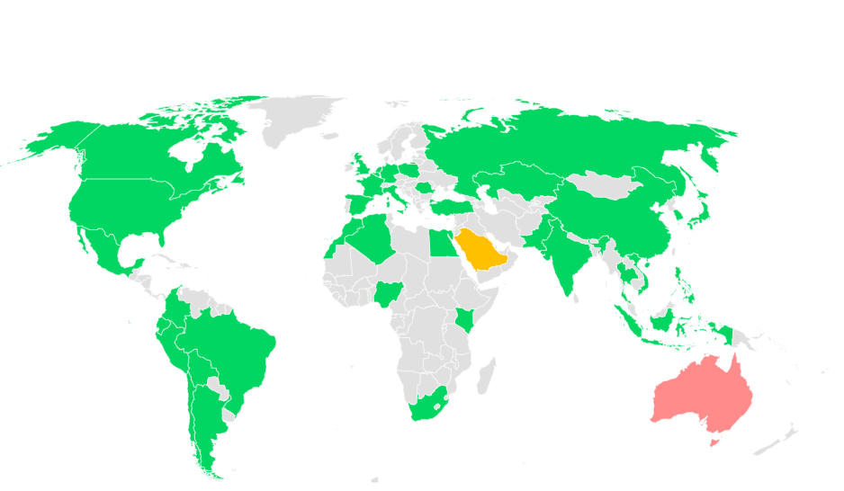
Regulatory Review for Returnable Glass Bottles
Permitted (37 markets, 95%): Algeria, Argentina, Belgium, Bolivia, Brazil, Canada, Chile, China, Colombia, Ecuador, Egypt, France, Germany, India, Indonesia, Italy, Japan, Kazakhstan, Kenya, Mexico, Morocco, Netherlands, Nigeria, Pakistan, Peru, Philippines, Poland, Romania, Russia, South Africa, South Korea, Spain, Thailand, Turkey, UK, USA & Vietnam
Limited use (1 market, 2.5%): Saudi Arabia Prohibited for carbonated beverages- glass bottle made of soda-lime-silica glass up to 1 litre Permitted for use for other use
Not possible (1 market, 2.5%) Australia

Slide 9
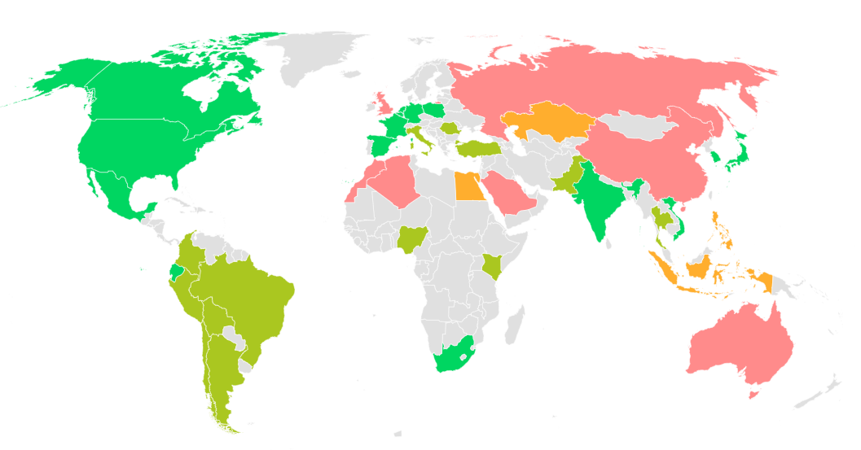
Competitor Review for Returnable Glass Bottles
3 or more activities of competitors have been identified (14 markets, 36%) Belgium, Canada, France, Germany, India, Japan, Mexico, Netherlands, Poland, South Africa, South Korea, Spain, USA, Vietnam
1-2 activities of competitors or a large national company have been identified (14 markets, 36%) Argentina, Brazil, Bolivia, Chile, Colombia, Ecuador, Peru, Italy, Kenya, Nigeria, Pakistan, Romania, Thailand & Turkey
1 activity of competitors or a large national company have been identified (4 markets, 10%) Egypt, Indonesia, Kazakhstan & Philippines
Activities of small national company have been identified or no activity has been identified (7 markets, 18%) Algeria, Australia, China, Morocco, Russia, Saudi Arabia & UK
Activities of small national company have been identified or no activity
7 markets

Slide 10
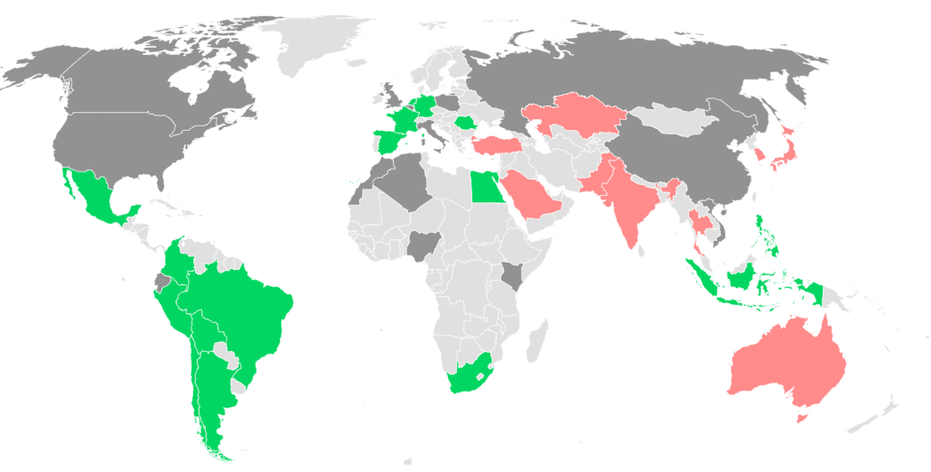
Regulatory Review for Returnable PET Bottles
Permitted (16 markets, 41%) Argentina, Bolivia, Brazil, Chile, Colombia, Egypt, France, Germany, Indonesia, Mexico, Netherlands, Peru, Philippines, Romania, South Africa & Spain
Not clearly regulated (14 markets, 36%) Algeria, Belgium, Canada, China, Ecuador, Italy, Kenya, Morocco, Nigeria, Poland, Russia, United Kingdom, USA & Vietnam
Prohibited/not recommended (9 markets 23%) Australia, India, Japan, Kazakhstan, Pakistan, Saudi Arabia, South Korea, Thailand & Turkey

Slide 11
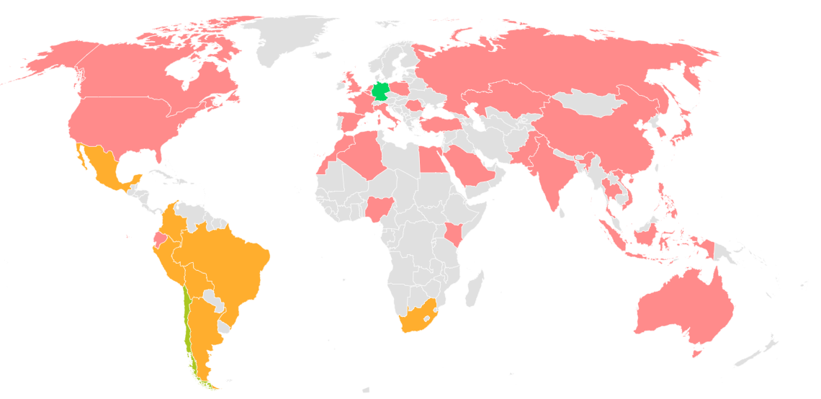
Competitor Review for Returnable PET Bottles
3 or more activities of competitors have been identified (1 market 2.5%) Germany
TCCC product and PepsiCo product has been identified (1 market 2.5%) Chile (PepsiCo product is labelled as returnable, however, unable to confirm if these bottles from PepsiCo are retuned and refilled or recycled
Only TCCC product have been identified. No competitors activity identified (7 markets, 18%) Argentina, Bolivia, Brazil, Colombia, Mexico, Peru & South Africa
Not permitted (10 markets 26%): Australia, Egypt, India, Japan, Kazakhstan, Pakistan, Saudi Arabia, South Korea, Thailand & Turkey Permitted but no competitors activity identified (20 markets 51%) Algeria, Belgium, Canada, China, Ecuador, France, Indonesia, Italy, Kenya, Morocco, Netherlands, Nigeria, Philippines, Poland, Romania, Russia, Spain, UK, USA & Vietnam

Slide 12
Newly established, up-coming & discussion regulations
Newly established
In discussion

Slide 13
Timeline
Market | Date | Comments
Chile | December 2022 Q1 of 2023 | The draft Regulation determine the percentage of returnable format bottles available for sale that supermarkets must offer is expected. Public consultation is expected of the draft Regulation
 | From 13 February 2023 From 13 August 2025 | Consumers must be able to give back empty returnable plastic bottles to supermarkets Consumers must be able to give back empty returnable plastic bottles to other establishments selling beverages shall offer this service
EU | 30 November 2022 2030 2040 | European Commission published a proposal for a revision of EU legislation on Packaging and Packaging Waste. The proposal sets: 20% reuse target for drinks packaging by 2030 75% reuse target for drinks packaging by 2040
France | 31 December 2025 | 20% reduction of single-use plastic packaging of which at least half will be achieved through reuse
 | 31 December 2022 2023 | First prototypes of standard packaging for returnable glass bottles should be ready. Standardised returnable glass should be marketable
Italy | 1 January 2024 | Plastic Tax coming into force
Poland | 2023 | A nationwide deposit system will be introduced for glass and plastic bottles
Romania | 30 November 2023 1 July 2023 | A deposit return scheme (‘DRS’) for beverage packaging will be mandatory. Manufacturers and operators bear the obligation to register with DRS system.
Spain | January 2023 | Plastic tax to enter into force
 | H1 of 2023 | A Draft Decree to be approved within 6 month to set reuse targets for beverage packaging
Turkey | 01 January 2023 | The transition/adaptation process for companies that offer reusable packages to the market will prepare and submit a deposit plan through the Packaging Information System prepared by the Ministry has been postponed to 1/1/2023 in order to be included in a national-scale central deposit management system.
UK | 16 August 2023 | Scotland DRS coming into force

Slide 14
Market Reports

Slide 15
What the colours mean
Overall |  | Regulatory |  | Competitor Analysis
There are clear opportunities to use reused glass/PET bottles for soft drinks i.e. Specific permissions identified General rules which allow reuse of packaging and successful competitor activities identified |  | There are specific regulations, rules/comments indicating the use of reused glass/PET bottles are permissible |  | Competitor activity has been identified
There may be a possibility to use reused glass/PET bottles for soft drinks i.e. No specific permission but general rules to allow reuse of packaging and No competitor activities identified |  | There are general rules for reuse of packaging but not specifically addressing reused glass / PET bottles |  | No competitor activities identified
Issues identified with use of reused glass/PET bottles i.e. Specific prohibitions; or Unsuccessful competitor activities; Discussion to prohibit Other issues e.g. operational issues identified |  | There are specific regulations, rules/comments indicating the use of reused glass/PET bottles are not permissible |  | No competitor activities identified

Slide 16


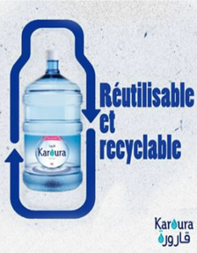
No clear regulation nor competitor activities identified, but labelling rules suggest returnable glass bottles are permitted
Market Analysis
Glass bottles | PET bottles
No evidence to support returnable bottles
Commercialised products in returnable bottles were not identified although the regulation allows returnable glass bottles
Only one returnable bottle example identified; Karoura’s 19L plastic water bottled
In 2004 the national waste agency l’Agence Nationale de Gestion des déchets (AND) introduced Eco-Jem, an EPR scheme in the form of a tax imposed on containers to incentivise manufacturers to pay for a system of waste collection and recovery. However, Eco-Jem has yet to be implemented due to a lack of clarity regarding where the financial burden lays, with the producer or the seller
ALGERIA
Large plastic bottles are available for reuse

Slide 17
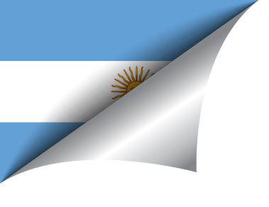
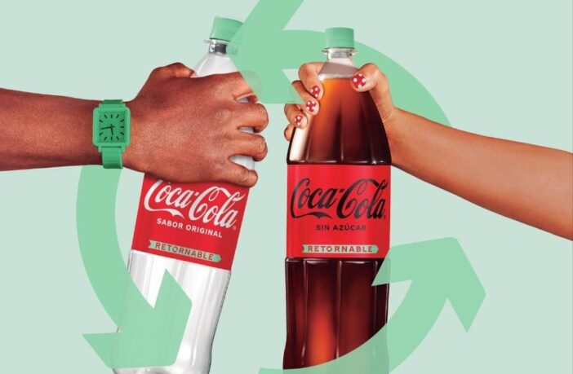
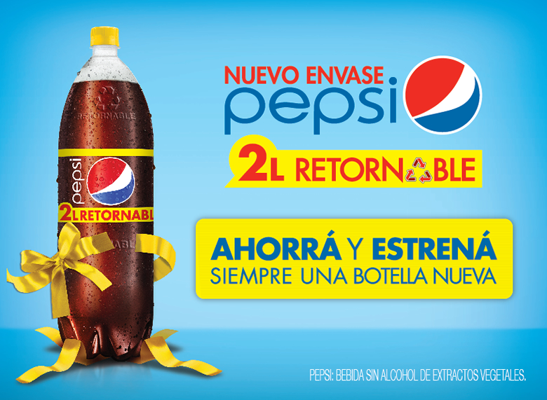
Returnable glass bottles are on the market, but the only returnable PET bottles are from Coca-Cola
Market Analysis
Glass bottles | PET bottles
Returnable glass bottles
Returnable glass bottles are a common practice – consumers can return empty bottles to supermarkets, convenience stores, etc.
Multiple manufacturers including AB InBev, Heineken, and PepsiCo are using returnable glass bottles
For returnable beer bottles, consumers can use a mobile app, which is developed for the return system, to collect a reward for returned bottles and use the reward to buy new returnable beer bottles
Returnable PET bottles
The Argentinian government is working on the development of a packaging law, which may include a tax (single use plastic tax) for those companies using non-recyclable plastics with a purpose of encouraging the use of returnable and/or recyclable packaging
However, research did not identify any evidence of returnable PET bottles for reuse/refill other than Coca-Cola
Coca-Cola’s returnable PET bottles
ARGENTINA
PepsiCo has launched returnable PET bottles for recycle

Slide 18


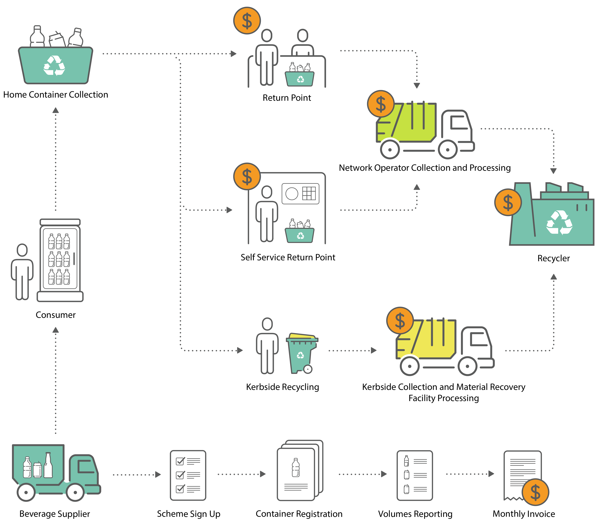
Mandatory deposit scheme makes it difficult to practise reuse/refill of glass and PET bottles
Market Analysis
Glass bottles | PET bottles
Returnable bottles are not possible due to the deposit scheme
The deposit scheme for glass and PET bottles established by each State makes it impossible to have returnable bottles
For example, in New South Wales, there is no clear prohibition for reusing bottles, but the current container deposit scheme does not allow for bottles to be returned and refilled
Most drink bottles are required to be part of the container deposit scheme which means that containers are marked with a barcode and the 10c return mark. Consumers then return the empty containers into designated refund points. The empty containers are separated, recycled and converted into new bottles and other food grade packaging
South Australia’s government asked for ideas on measures to better protect our environment from impacts associated with single-use plastic products and to further improve the effectiveness of South Australia’s container deposit scheme. Prior to a container deposit scheme, refillable glass bottles for beer and soft drinks were collected via voluntary schemes established by the manufacturers of those beverages
Target 1 of the ANZPAC Plastics Pact (ANZPAC) it to eliminate unnecessary and problematic plastic packaging through redesign, innovation and alternative (reuse) delivery models
Deposit scheme operations to recycled bottles
AUSTRALIA

Slide 19


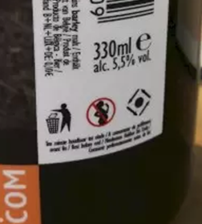
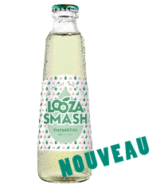
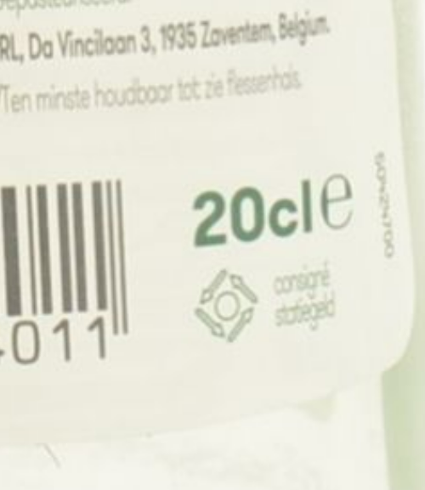



Ecotax applies to non-refillable beverage containers
Market Analysis
Glass bottles | PET bottles
Ecotax and voluntary deposit scheme
“Ecotax” is a mandatory tax for beverage containers that are not refilled; however, it is not a nationally recognised deposit scheme
Instead, containers may be exempted from this tax if the manufacturer participates in a voluntary deposit scheme for the container
Returnable glass bottles in the voluntary deposit scheme have a logo, and consumers must return the bottles with a logo to the store
BELGIUM
Recent regulatory changes
The Wallonia and Brussels Capital Region both have pilot deposit schemes. The Wallonia pilot tests out collection by both reverse vending machine and manual collection, putting a 5-cent deposit on cans. The Brussels pilot extends to both cans and plastic bottles
In 2020, the Belgian government published a coalition agreement which "includes the possibility to incorporate a deposit return scheme in the packaging tax during this legislature”
Logos for returnable bottles
Alken-Maes (AB InBev)
Tropicana Looza Cucumber (PepsiCo)

Slide 20

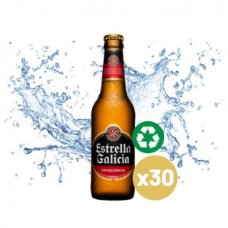
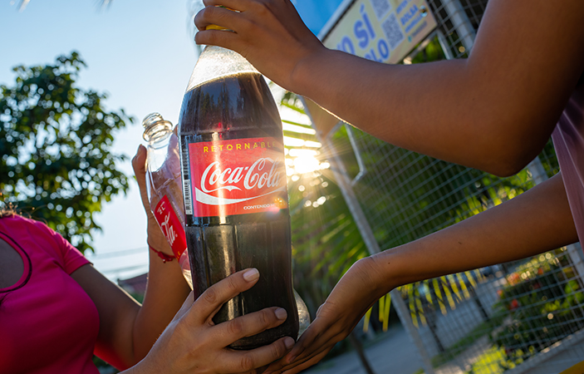
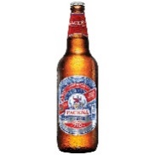
Returnable glass bottles are on the market, but the only returnable PET bottles are from Coca-Cola
Market Analysis
Glass bottles | PET bottles
Returnable glass bottles are a common practice – consumers can return empty bottles to stores
Evidence or activities from major competitors was not found
A few examples from major alcoholic beverage manufacturers in Bolivia were identified however
The regulations also permit returnable PET bottles
Coca-Cola is the only beverage manufacturer with products in returnable PET bottles on the market
BOLIVIA
Coca-Cola Bolivia launched a 2.5 litre Coca-Cola in returnable PET bottles in April 2022
Returnable glass bottles on the market
Cervecería Boliviana Nacional
Estrella Galicia

Slide 21
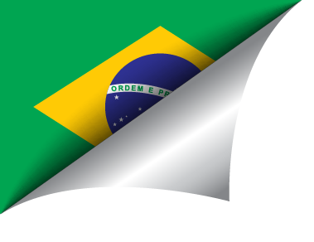
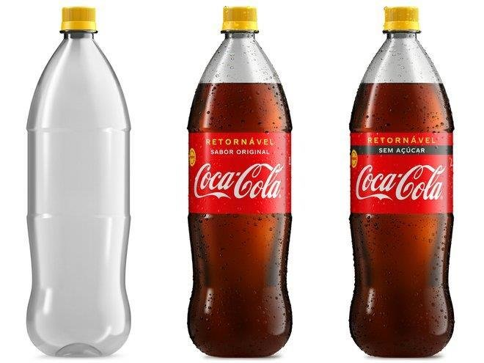
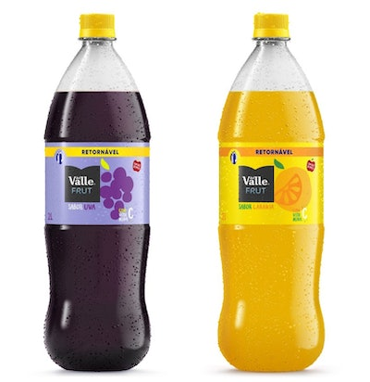
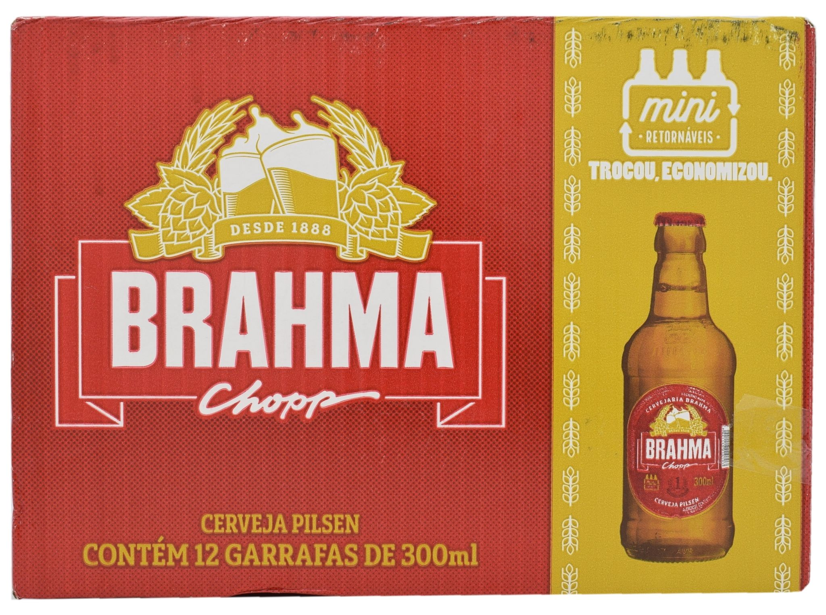
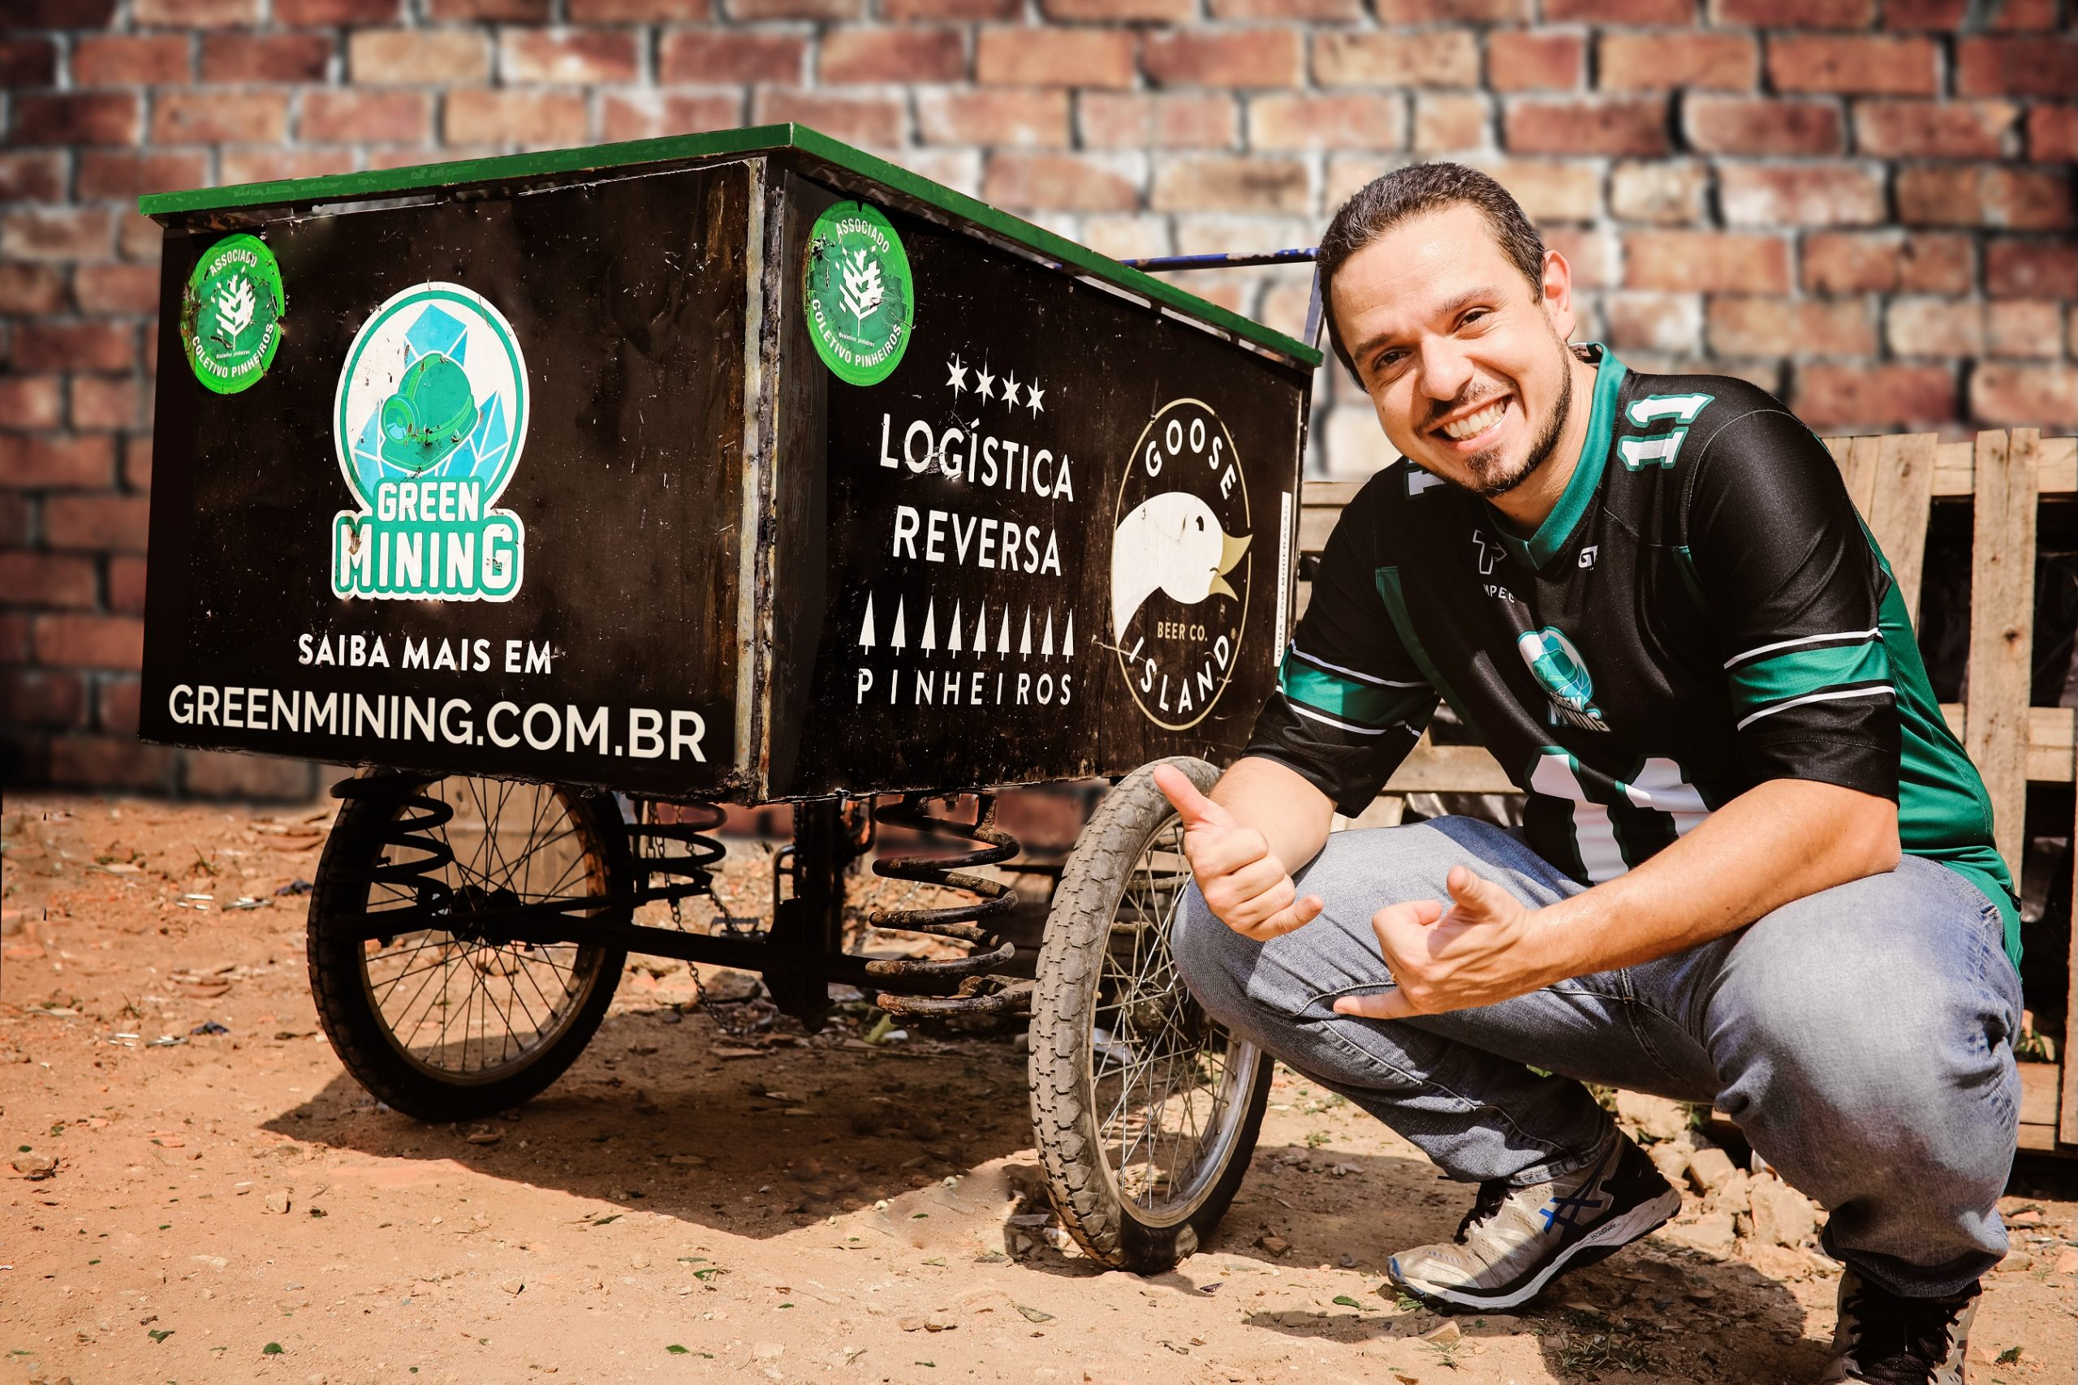
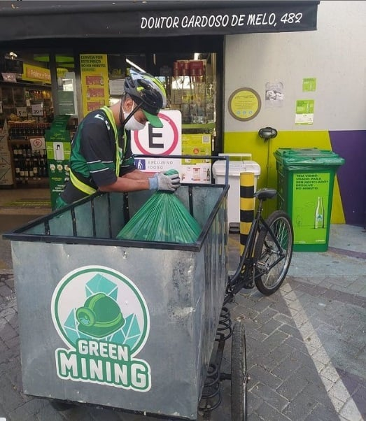
Rateable Glass bottles are used but only Coca-Cola uses returnable PET bottles
Market Analysis
Glass bottles | PET bottles
Both glass bottles and PET bottles are permitted to reuse/refill
Multiple products in returnable glass bottles are commonly available, manufactured from different producers including AB InBev
However, Coca-Cola is the only beverage producer with returnable PET bottles on the market
Coca-Cola’s returnable PET bottles
BRAZIL
Green Mining project by AB InBev
AB InBev has invested in Green Mining, a Brazilian start-up finding innovative solutions to keep packaging out of landfills.
“Green Mining is an exciting Brazilian start-up that “mines” empty glass bottles in high-consumption areas and uses blockchain to guarantee full tracking of bottles’ origin, transportation and destination. The initiative also works to formalize the work of waste collectors, providing collection and safety equipment and ensuring secure incomes for collectors. Green Mining started their operations in November 2018 and has setup collections points operating in states throughout Brazil. The glass they collect goes directly to our own vertically integrated glass plant.”
Brahma Chopp (subsidiary of AB InBev)

Slide 22



Bottle bills established on a provincial level
Market Analysis
Glass bottles | PET bottles
Glass bottles for reuse/refill are a common practice
Canada with a long history as well as a high collection rate (95%)
Permissibility of returnable bottles varies by province
Example 1: Industry standard bottle in British Columbia, Ontario and Quebec
Brewers have the option of using the industry standard bottle through an agreement with the national beer association, Beer Canada, to sidestep provincial environmental levies for non-refillable packaging
Example 2: Prince Edward Island
Prince Edward Island traditionally banned non-refillable containers for beer and soft drinks, but this ended in 2008. Currently, non-refillable containers have only half of their deposit returned
CANADA

Slide 23

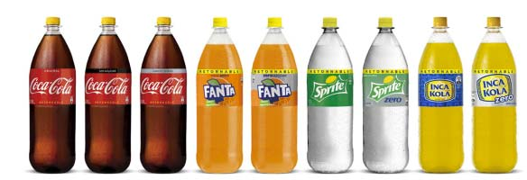
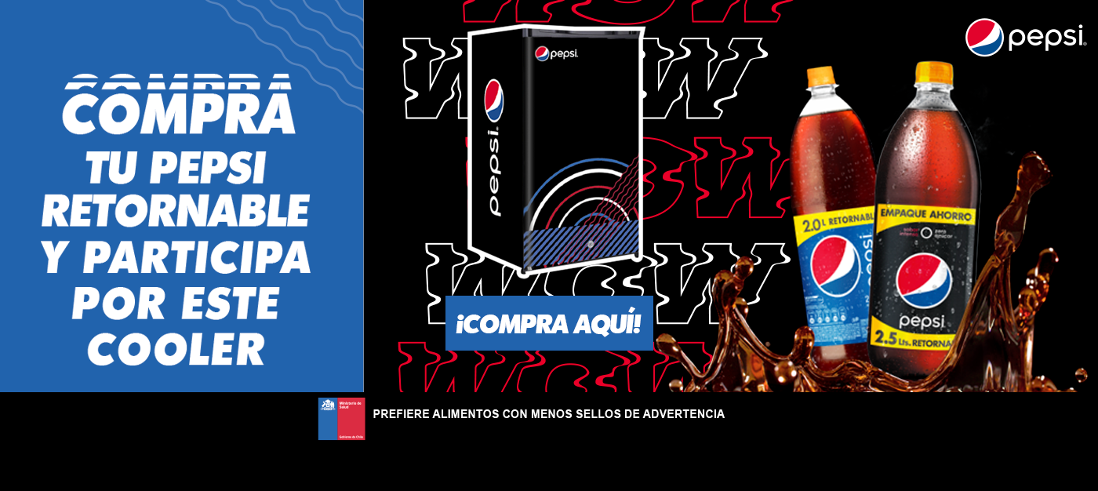
Chile promotes the use of returnable bottles – glass and PET
Market Analysis
Glass bottles | PET bottles
Returnable glass bottles
Returnable glass bottles are commonly available – several products from multiple manufacturers including Heineken and AB InBev identified on the market
Returnable PET bottles
Introduction of plastic regulation bill in 2021 allows the sale of reusable beverage containers
Beverage suppliers must offer and take back returnable PET bottles
A couple of returnable PET bottle examples identified from Coca-Cola and PepsiCo; however, unable to confirm if these bottles from PepsiCo are retuned and refilled or recycled
The Chile Plastics Pact have a target ‘1/3 of household and non-domiciliary plastic packaging to be recycled, reused or composted’
Coca-Cola returnable botte
CHILE
Pepsi returnable botte
Returnable plastic bottles target
From 13 February 2023 consumers must be able to give back empty returnable plastic bottles to supermarkets; while other establishments selling beverages shall offer this service from 13 August 2025.
The Regulation to the Law will determine the percentage of returnable format bottles available for sale that supermarkets must offer but this has not been published, yet.

Slide 24
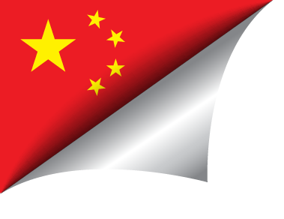
Very limited evidence to support the use of returnable glass bottles, however general rules suggests glass and PET returnable bottles maybe allowed
Market Analysis
Glass bottles | PET bottles
Returnable glass bottles
Lack of evidence/examples although the regulations allow the use of returnable glass bottles – no significant activity from competitors identified
  A post (Dec 2021) on a consumer’s social media shared a post to ask the soft drink company “Bei Bing Yang” in Beijing about their glass drink bottles – the date marking on the lid of the drink was a recent date, but the date embossed on the bottle was an old date in 2020. The company replied to say it is safe to reuse glass bottles
  Court cases related to breach of trademark/copyright when a company reuses other brands’ beer glass bottles, but failed to cover up the embossed brand name
Returnable PET bottles
There are two national standards addressing the reuse/refill of packaging in general
These general principles may indicate that the reuse/refill of packaging would be acceptable if the packaging is not classified as “solid wastes” and still meets all the applicable criteria and specifications as “the original (new or clean) state”
However, it is not clear if PET bottles can meet the criteria and specifications to be returned for reuse/refill since any particular type of materials are not specified in those standards
Pressure from experts
According to the “General Principles’ any packaging that can be used for original purposes without repair and processing, or after the production point has been repaired and processed to meet the country, locally established or industry-required product quality standards and packaging for original use may not be managed as solid waste. Therefore, when the company recycles its own glass bottles, it retains its original use. These used old glass bottles should not be disposed of as solid waste.” – Fang Gang, Senior Engineer, Research Center for Cleaner Production Academy of Environmental Sciences
“Mandatory recycling should be included in local legislation.” – Chang Jiwen, Deputy Director, Institute of Resources and Environmental Policy of the Development Research Center of the State Council
CHINA

Slide 25

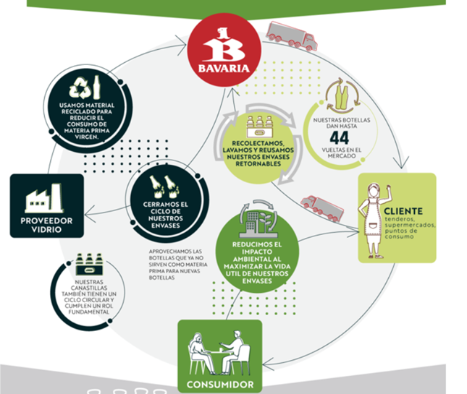
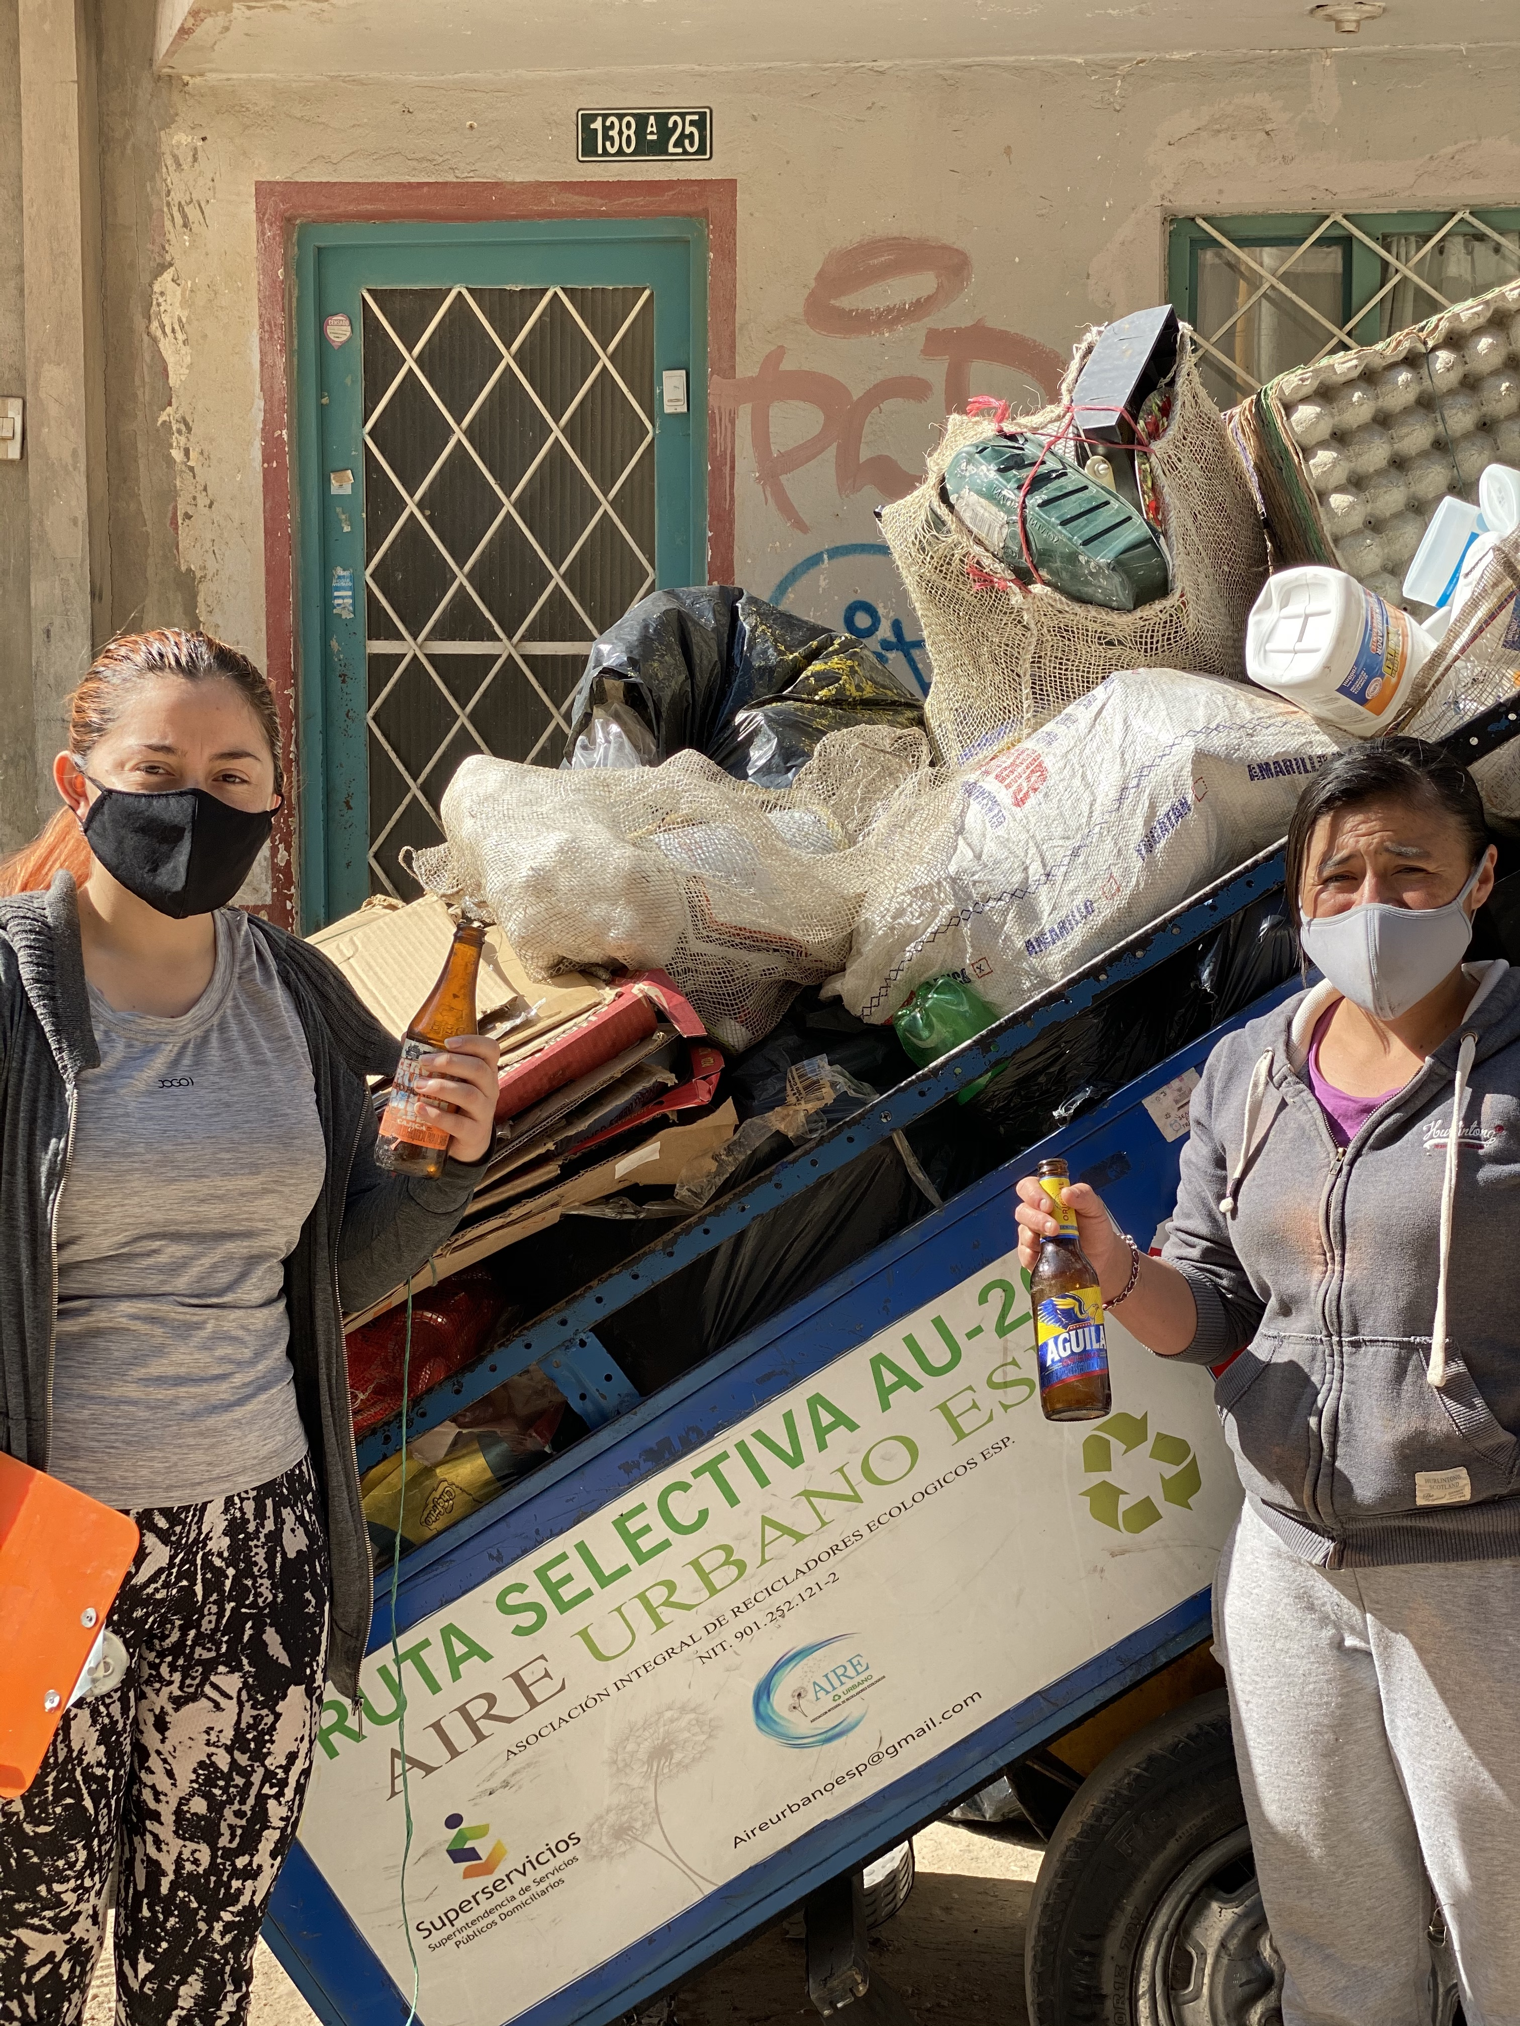
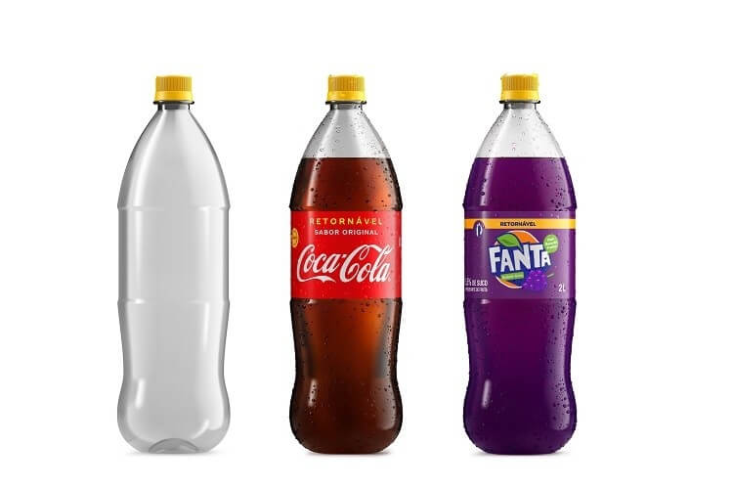
Returnable glass bottles are used but only Coca-Cola uses returnable PET bottles
Market Analysis
Glass bottles | PET bottles
Returnable bottles are permissible
Both glass bottles and PET bottles are permitted to reuse/refill
However, the evidence of returnable PET bottles is limited while returnable glass bottles are widely available
COLOMBIA
Postobón’s collection service
Postobón collects used packaging directly from consumers, allowing them to request the collection service for their post-consumer packaging at home
Coca-Cola launched the “Universal Bottle” in Colombia and other Latin American countries after a successful debut in Brazil in 2018
AB InBev is initiating activities for better collection and processing of returnable glass bottles
Return Home project
Launched in 2020 in Bogota to connect recycling collectors and cooperatives with restaurants and bars around the city to improve collection of returnable glass bottles and increase waste pickers’ incomes. Partnered a couple of 100+ Accelerator start-ups, Nomo Waste and BanQu.
Bavaria’s process for returnable glass bottles

Slide 26
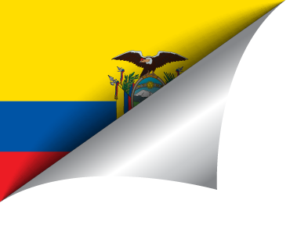
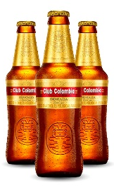
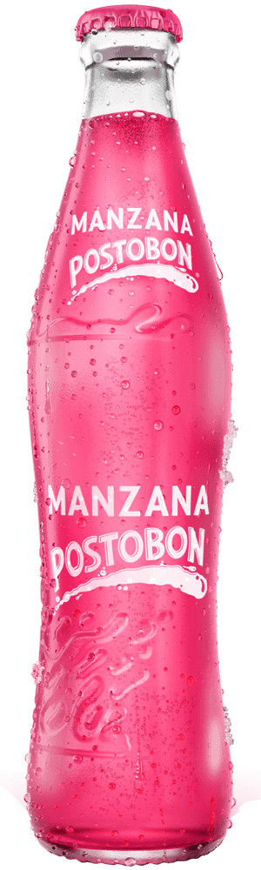
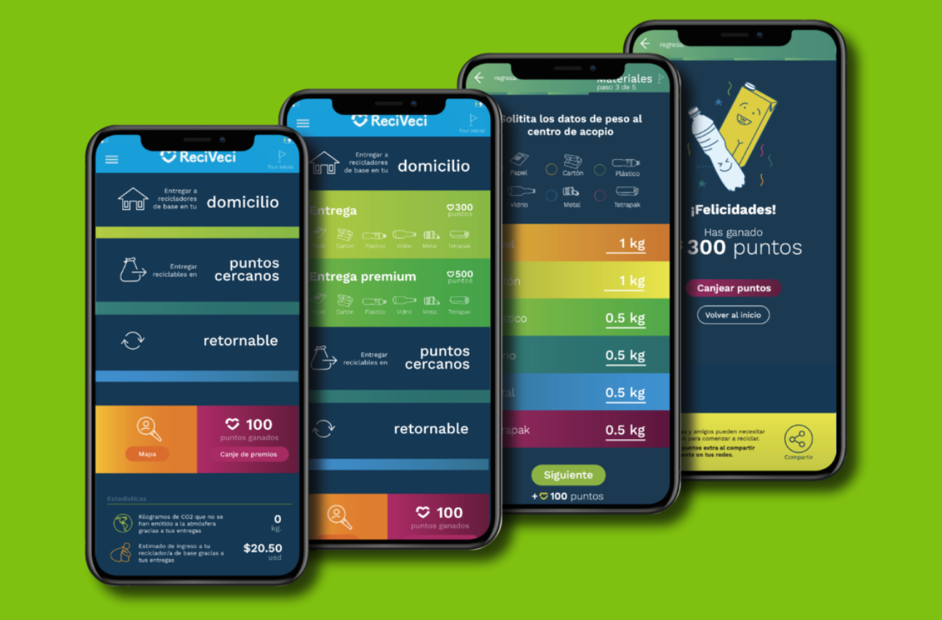
Returnable glass bottles are used but only Coca-Cola uses returnable PET bottles
Market Analysis
Glass bottles | PET bottles
ReciApp by ReciVeci
ReciVeci is a social start-up that promotes the proper separation of solid waste in Ecuador, connecting the recyclable waste chain through an inclusive recycling system. ReciVeci is one of 100+ Accelerator, collaborating with Coca-Cola.
The app ReciApp integrates a reward system to award users with points each time they drop off their recyclable waste. These points can be used afterwards to obtain gifts from companies adhered to the programme.
ECUADOR
Returnable glass bottles are a common practice, with various products from multiple beverage manufacturers

Slide 27
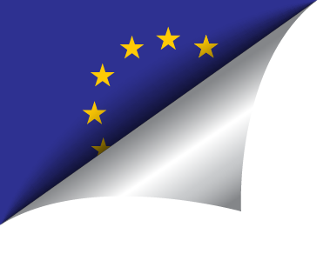
Leaked EU 75% reuse target for drinks packaging
Market Analysis
Glass bottles | PET bottles
Check EU MS | Check EU MS
New leaked proposed target
The European Commission is due to release a proposal to revise the EU’s Packaging and Packing Waste directive on 30 November 2022.
The leaked proposal is to set a 75% reuse target for drinks packaging by 2040 and 20% by 2030. The leaked details show that planned targets would apply in a country-by-country basis to each individual manufacturer.
The European Fruit Juice Association, UNESDA Soft drink Europe, The Brewers of Europe and Martial Mineral Waters Europe, have joined forces to fight the planned measures and in a joint statement ‘expressed our utmost concerns; about the leaked target’.
Existing targets
The 2018 regulation did not lay down reuse targets. It contained a clause giving the Commission until 31 December 2024 to ‘examine data on reusable packaging provided by Member States.’ with a view to consider the feasibility of setting quantitative targets on reuse of packaging, including the calculation rules, and any further measures to promote reuse of packaging.
Drink makers already have to comply with some recycling targets but not specifically for reuse. Under the EU’s 2019 single-use plastic directive, PET bottles will have to contain at least 25% recycled plastic by 2025, rising to 30% from 2030.
The directive also set a 77% separate collection target for plastic bottles by 2025, increasing to 90% by 2029.
EUROPEAN UNION
TCCC

Slide 28

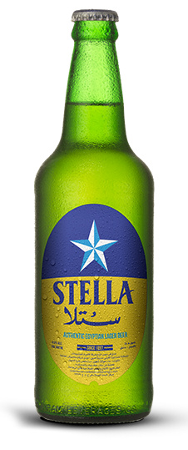
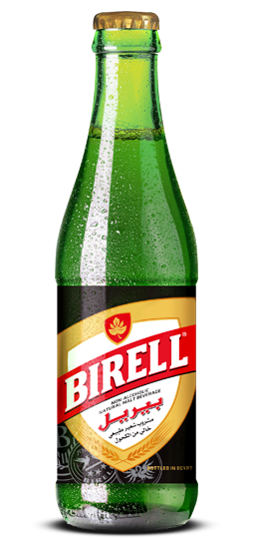
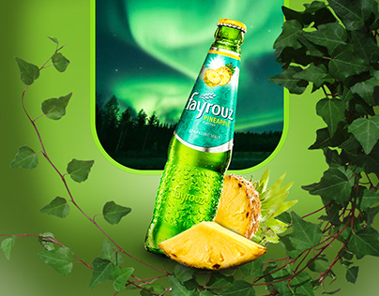
Glass returnable bottles are permitted but no infrastructure to support is in place and new regulation published related to FCM
Market Analysis
Glass bottles | PET bottles
EGYPT
Returnable glass bottles
Returnable glass bottles are widely available
However, it is unclear how bottles are returned and prepared for refilling
Returnable PET bottles
Decision No. 17 of 2022 stipulates that in the case where establishments are authorized to reuse containers, they must comply with the rules laid down under this decision in all refill cycles.
However, major beverage manufacturers have launched their initiatives to support plastic recycling:
  PepsiCo launched “Recycle for Tomorrow” which is a waste management platform, aiming to collect and recycle 8M kg of plastic waste in 2021 and raise awareness about the importance of recycling plastic waste
  Nestlé launched its initiative, DORNA, to collect and recycle plastic packaging waste in collaboration with the Egyptian Ministry of Environment, CID Consulting and PayMob
Al Ahram Beverages Company manufactures beer and flavoured malt beverages in returnable glass bottles (e.g. Stella, Birell, FAYROUZ)

Slide 29

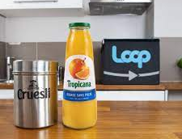
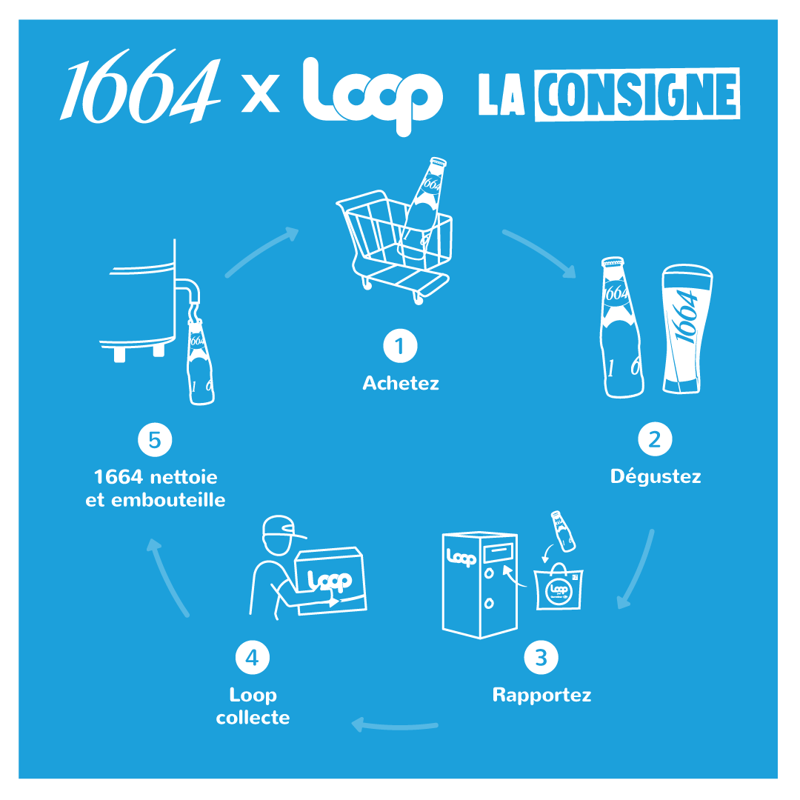
Strong political will to develop the returnable glass and PET bottles schemes with reuse targets and ongoing trials to support
Market Analysis
Glass bottles | PET bottles
National reuse target established
Décret 3R sets objectives including a target of 20% reduction of single-use plastic packaging by the end of 2025, of which at least half will be achieved through reuse
However, no returnable PET bottles have been identified on the market
Returnable bottles contribute to EPR calculations
FRANCE
Loop trial in Paris
Terracycle piloted a refillable container trial via their Loop platform with Carrefour and multiple FMCG brands in Paris in 2019
Participating brands included: Coca-Cola (Coca-Cola European Partners), Tropicana (PepsiCo), Kronenbourg (Heineken), Evian (Danone), Hellmann’s (Unilever)
Trial to standardise reuse of bottles
Actively running trials with organisations and manufacturers to seek potential of reuse/refill of glass and PET bottles with regulatory support
Competitors such as PepsiCo, Danone, Heineken, and Unilever are participating in those trials – mostly with glass containers
To develop the reuse of packaging on a larger scale, the CITEO eco-organisation, in partnership with manufacturers, conducted a study to propose standard packaging.
For glass packaging, first prototypes of standard packaging should be ready at the end of 2022, and marketable in 2023.
For other materials, including PET, tests are being carried out over 20 cycles and the aptitude for food contact (overall, specific migration, coloration and variation, organoleptic) is evaluated to validate the conformity of certain materials on several reuse loops.

Slide 30

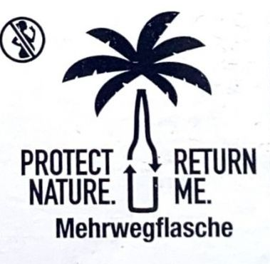
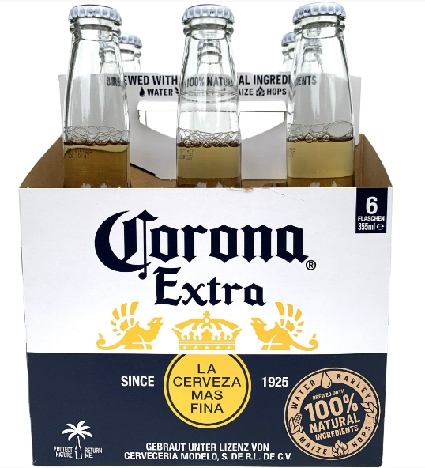
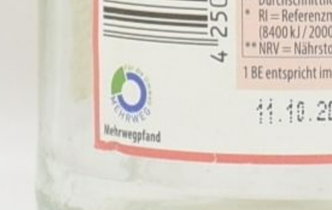

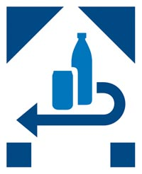
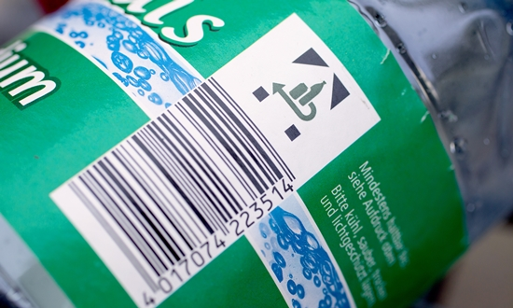



Returnable glass and PET bottles are a common practice with voluntary logos. Single-use bottles must be labelled
Market Analysis
Glass bottles | PET bottles
Returnable bottles are permissible and common practice
The regulations allow both glass bottles and PET bottles to be reused/refilled
Bottles for reuse/refill can bear a label with a relevant logo voluntarily
On the other hand, single-use bottles must have the Pfand (deposit) symbol
GERMANY
For glass bottles
Mehrweg (meaning reusable)
One of most common reusable logos for both glass bottles and PET bottles
Labelled on 500+ products from 130+ beverage manufacturers, including PepsiCo
Punica Grapefruit (PepsiCo) in a glass bottle
Blauer Engel
Logo for certified environmentally sound returnable bottles
7 certified glass bottles and 1 PET bottle (alwa Mineralbrunnen)

Slide 31
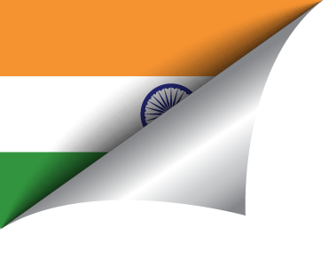
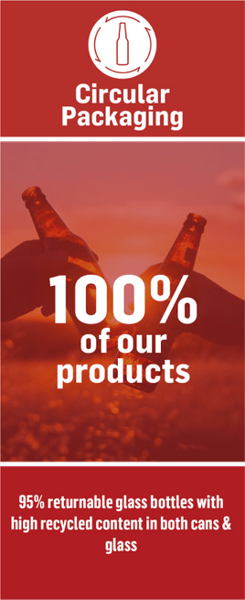
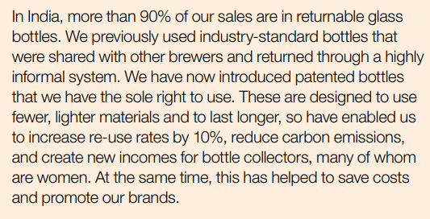
Clear regulatory permission and common use of returnable glass bottles; however, returnable PET bottles are not permitted despite ‘reuse’ target for plastic packaging under the new EPR programme
Market Analysis
Glass bottles | PET bottles
EPR programme for plastic packaging
The Indian Ministry of Environment published guidelines for an expanded extended producer responsibility (EPR) program for plastic packaging in February 2022
The program sets increasingly strict targets for ‘reuse’ of plastic packaging
However, PET bottles are excluded due to the provisions established in Food Safety Regulation
Only plastic bottles above the volume of 5L may be refilled/reused
India Plastics Pact include a target of ‘Understanding and adoption of reuse models'. This maybe an opportunity to allow returnable PET bottles
INDIA
AB InBev
Primary packaging that is recyclable or reusable: 95% (2022)
SABMiller (subsidiary of AB InBev)
Primary packaging that is recyclable or reusable: >90% (2016).
*Coca-Cola’s rate of primary packaging that is recyclable or reusable is 95% in 2021

Slide 32

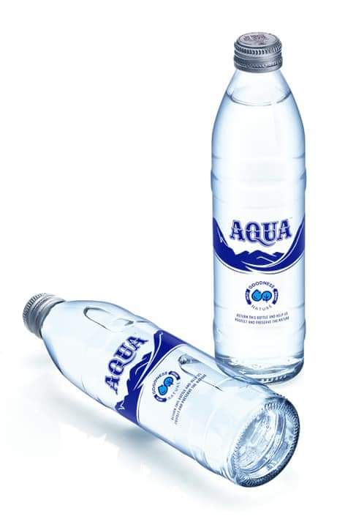
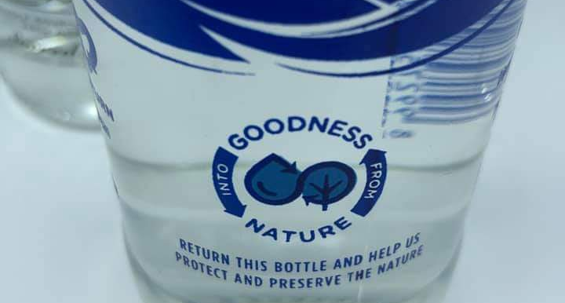
Returnable glass and PET bottles are highly recommended by regulation; however, no evidence to support the use of returnable PET bottles
Market Analysis
Glass bottles | PET bottles
Support for reuse/refill of glass and PET bottles
Reuse of glass and PET packaging for food and beverages are not only permitted but highly encouraged by the regulations
The industry has to reduce their production waste by 30% by 2029
The regulation indicates that the packaging would need to bear a statement to inform consumers that the packaging can be reused
In 2020, the Indonesia Packaging Recovery Organization (IPRO) was set up by private sector operators. Members of IPRO include Coca Cola, Danone, Indofood, Nestle, Tetra Pack, Unilever, PT HM Sampoerna Tbk., SIG, SC Johnson and Suntory Garuda
Additionally, circular economy platform Octopus Waste management PTE. Ltd was formed in 2022. Octopus helps producers to: 1. track and collect their post-consumer product, 2. give incentives directly to verified stakeholders
INDONESIA
AQUA (Danone) in returnable glass bottle for B2B
In 2020 Danone re-launched a returnable glass bottle for drinking water AQUA for hotels and cafes in Bali
The bottle has a logo to promote returning of the bottle

Slide 33

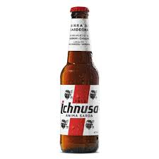
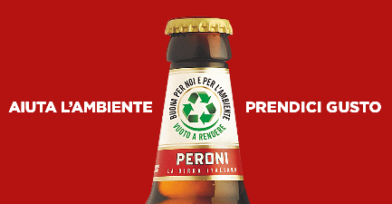
Returnable glass bottles are permitted but not commonly used
Market Analysis
Glass bottles | PET bottles
Returnable glass bottles
Although the regulations permit reuse/refill of glass bottles, returnable glass bottles are not commonplace on the market
A couple of examples from beer manufacturers including Heineken and Asahi identified
Returnable PET bottles
There is no clear rule on the use of returnable PET bottles
A campaign to launch a Deposit scheme for plastic bottles has been launched, however, the petition has not reached the required numbers and therefore is still under discussion
The Italian Consumer Association (Altroconsumo) published a study regarding the reuse of PET bottles, stating that PET bottles are designed and marketed for single use only
Italian Plastic Tax will enter into force 2024 appliable to PET bottles
Ichnusa (Heineken): “As we grow, we invested in sustainable, returnable bottles in Italy.”
ITALY
Bierra Peroni (Asahi Brewery) introduced returnable beer bottles, which are able to be reused 15-18 times

Slide 34





Returnable glass bottles are a common practice for alcoholic and non-alcoholic beverages via B2B channels (e.g. hotels, restaurants & bars)
Market Analysis
Glass bottles | PET bottles
Returnable glass bottles
Widely available for various beverage products from multiple major beverage manufacturers including Coca-Cola and license holders of PepsiCo and Heineken
Returnable PET bottles
Unlike glass bottles which are widely returnable in Japan, returnable PET bottles are discouraged by the Ministry of Environment due to results from a trial carried out in 2008 which demonstrated:
The environmental burden (emission of carbon dioxide) of returnable PET bottles is superior to that of a single-use PET bottles only when the reused PET bottles are used and collected in closed conditions (within the distance of less than 100 km with 90% or higher collection rate)
Difficult to remove contaminants attached to the inner wall of PET bottles when they are contaminated by chemicals due to misuse by consumers to the extent of health concern
JAPAN
Recycle logos
Recycling logos from Japan Glass Bottle Association
Otsuka Pharmaceutical in July 2022 launched its first product in returnable glass bottles for the Loop Platform

Slide 35




Kazakhstan is trying to revive the culture of returning glass bottles, but returnable PET bottles are prohibited
Market Analysis
Glass bottles | PET bottles
Returnable glass bottles
Kazakhstan launched a pilot project in 2017 to develop reusable glass containers, which concluded that the reuse of glass bottles is preferable
Kazakhstan Association for Waste Management (KazWaste) stated that in 2020 there were around 50 glass container collection points in the city of Almaty alone, and the glass bottles were being reused by local breweries such as EFES Kazakhstan (partner of AB InBev) and Caspian Beverage Holding
However, it is not clear if any AB InBev’s products are distributed in returnable glass bottles under EFES Kazakhstan
Returnable PET bottles
FCM regulation establishes rules for PET bottles to be used once indicating multi-use of PET bottles is not acceptable
KAZAKHSTAN
Large multi-use water plastic bottles are widely available on the market; however, these bottles are mostly PE-based (e.g. HDPE), not PET

Slide 36



Some evidence of returnable glass bottles. Targets to increase reuse under Kenya Plastics Pact may provide opportunity for returnable PET bottles
Market Analysis
Glass bottles | PET bottles
Returnable glass bottles
The regulations permit returnable glass bottles
Products in returnable glass bottles are available
Returnable PET bottles
Although there is no clear permission or prohibition, Kenya Plastics Pact published a roadmap outlining targets and steps necessary to reach the primary goal of eliminating plastic waste by 2030
Target 2 include:
  Improved adoption within retailers / brands of issues of reuse models
  Increased business and citizen understanding of reuse and recycling
  Improved understanding of policy environment relating to reuse and recycling of plastic packaging
As this target is for all plastic it is reasonable to assume it includes PET bottles and therefore returnable PET bottles may be acceptable
KENYA
254 Brewing
Bottles can be collected by participating partner stores such as Greenspoon
“All 254 beer bottles can be washed and returned to us for reuse, as an added bonus the deposit for the bottle will be credited to your Greenspoon account”
Coca-Cola
The Ministry of Environment and Forestry has been in the process of developing Kenya’s first EPR regulation. The regulation would require companies to either independently or jointly create an EPR compliance scheme that also covers minimum targets for reuse, recycling or recovery, as well as logistics for collection and product design guidelines. It covers glass and plastic.

Slide 37



Returnable glass bottles are used by competitors but returnable PET bottles are limited to Coca-Cola
Market Analysis
Glass bottles | PET bottles
Returnable bottles are permissible
The regulations permit both glass bottles and PET bottles for reuse/refill
Major beverage producers including PepsiCo, Heineken, and AB InBev manufacture products in returnable glass bottles
The use of returnable PET bottles by beverage manufacturers are limited to Coca-Cola and PepsiCo; however, PepsiCo’s returnable PET bottles are not for reuse/refill but for recycle
MEXICO
Bottle collection
Consumers may need to return empty bottles to specific collection centres (e.g. participating stores) and receive credits as a reward for the returned bottles that can be redeemed for a gift.
Alternatively, consumers can use apps for a discount when bottles are returned. The bottles are returned when the order is delivered.
PepsiCo launches “interchangeable” glass bottles for reuse
Returnable PET bottles by Coca-Cola

Slide 38

MOSSUP project has been launched with an end goal to increase collection of post-consumer plastic waste and improve the recycling rate of PET plastic
Market Analysis
Glass bottles | PET bottles
Returnable bottles permissibility
The authority confirmed that returnable bottles may be used; however, no evidence on the market has been identified
The use of returnable PET bottles would depend on the outcome of the ongoing MOSSUP project
MOROCCO
If phase 1 feasibility study (May - September 2022) shows fruitful outcomes, phase 2 of the project will be implemented, in which the business model will be piloted starting from October 2022.
Latest statement indicated a fully integrated national container deposit scheme modelled on the success of pilots A and B
Moroccan Supermarkets tackling Single-Use Plastics (MOSSUP) project
Initiated by Moroccan supermarket chains since spring 2021
Pilot A targets the concept of a circular green economy based on the collection and recycling of plastic bottles
  Involved the installation of bottle collection points in participating stores
  Customers are incentivised to take part in the scheme (e.g. a voucher or loyalty card points to spend in the store for each bottle returned)
Pilot B is a reusable food container scheme
  Consumers can pay a small deposit on a reusable container, and receive the deposit back when they return the container to the store
  The container is washed and reused at the store

Slide 39




National targets established to reuse glass and plastic packaging
Market Analysis
Glass bottles | PET bottles
Returnable glass bottles
Reuse of glass packaging is a common practice
In particular, glass bottles for beer and soft drinks in the catering industry are taken and refilled via a deposit system
The Netherlands set a combined target of reuse and recycling of 86% for glass; recycling of glass packaging at 70% by 2021, and 75% by 2030
NETHERLANDS
Recycle logos for glass bottles
Returnable PET bottles
No evidence of returnable PET bottles identified on the market
Netherlands has decided to make the reuse of plastic packaging common and scale up over phases
The Netherlands has published a report about the possibilities to introduce a national tax on virgin plastic
Collection point for returnable glass bottles

Slide 40

Heineken and AB InBev are working together to exchange returnable bottles
Market Analysis
Glass bottles | PET bottles
Industrial collaboration for returnable glass bottles
Heineken’s subsidiary in Nigeria and AB InBev are collaborating to establish an exchange returnable bottle programme for glass bottles
National Policy on Plastic Waste Management 2020 & Lagos State Plastic Waste Management Policy 2021
The government states that the overall goal of the policy is to promote sustainable use of plastic as a resource through its life cycle management
However, there is no clear indication if returnable PET bottles would be acceptable
NIGERIA

Slide 41



SWITCH-Asia SCP Facility provided a report on waste management to the Government with a possible phased trial on management tool including bottles collections
Market Analysis
Glass bottles | PET bottles
Returnable glass bottles
Carbonated beverages are generally available in reusable/refillable glass bottles
These bottles are seen as the property of the company and the customer is mandated to return it to the shopkeeper
Returnable PET bottles
The regulations indicate that PET bottles are single-use only and must be labelled as “Crush the Bottle after Use” in both English and Urdu
No regulatory pressure identified; however, an industry expert requested the government of Pakistan to either switch to glass bottles or implement strategies to reuse plastic bottles
PAKISTAN
Examples of returnable glass bottles
SWITCH-Asia
The SWITCH-Asia assignment was requested to design an effective capacity building intervention that would support Pakistan on the implementation of its waste and plastics management goals
The group discussed that plastic and packaging waste should be the product targeted through these pilot projects
It has been suggested that the pilot testing initiative may include glass bottles and PET bottles
The deliverables would include development of draft legislation/regulation for the institution of waste minimisation and recycling targets in Pakistan

Slide 42



Glass and PET returnable bottles on the market
Market Analysis
Glass bottles | PET bottles
Returnable bottle are permissible
The regulations permit both glass bottles and PET bottles for reuse/refill
Major beverage producers including Heineken, AB InBev, and PepsiCo as well as local companies manufacture products in returnable glass bottles
Empty glass bottles are returned to stores
The use of returnable PET bottles by beverage manufacturers are limited to Coca-Cola and PepsiCo; however, PepsiCo’s returnable PET bottles are not for reuse/refill but for recycle
PERU
Cusqueña’s returnable beer bottles (AB InBev)
Empty Cusqueña glass bottles can be returned to designated wineries or liquor stores nationwide. Consumers can save money (S/0.50) on the purchase of a new Cusqueña product.
PepsiCo’s returnable PET bottles for recycling
Returnable PET bottles by Coca-Cola

Slide 43


New EPR laws clearly allows and encourages reuse of glass and plastic (including PET) beverage packaging
Market Analysis
Glass bottles | PET bottles
Returnable PET bottles
The Philippines enacted the Extended Producer Responsibility Act of 2022, in July 2022
The EPR programme provides tax incentives following an approval process; however, details are not yet available
Recovering system by PARMS
Philippine Alliance for Recycling and Materials Sustainability (PARMS) announced that a group of its members (including Coca-Cola, Nestlé, Unilever, and Mondelez), including some of the country's largest multinational corporations, have committed to financing the recovery and diversion of plastic waste packaging, as well as address leakages to nature while continuing to work on redesigning packaging for a circular economy to ensure that future generations still have a viable place to live in (February 2022).
PHILIPPINES
Returnable glass bottles by San Miguel
San Miguel’s returnable glass bottle system helps keep the price of its beer products affordable. The Company is able to achieve more than 90% retrieval rate for its bottles, maximising bottle usage and substantially reducing its packaging costs.

Slide 44





Expanded deposit scheme from 2023 will support increase in returnable bottles
Market Analysis
Glass bottles | PET bottles
Returnable glass bottles common practice with hope for returnable PET bottles
Poland will introduce a nationwide deposit system in 2023 for glass and plastic bottles to collect and reuse 90% of such packaging by 2030
Currently, only glass bottles in a specific shape are returnable although the regulation allows deposits to be paid for glass beer bottles
There is no clear rules on returnable PET bottles; however, returnable PET bottles may be permissible if PET bottles meet the requirements for reusable packaging
Polish Plastics Pact include a target of ‘Conduct effective citizen engagement in the field of reduction, reuse, sorting and recycling of packaging’
POLAND
Returnable bottle logo
Żywiec (Heineken)
In 2020, the Żywiec brand was the first beer brand in Poland to launch the Great Verse of Ż promoting the donation of bottles among Poles for the benefit of the environment.
Kompania Piwowarska (owned by Asahi Breweries)
Kompania Piwowarska joined Carrefour Poland’s initiative “Road to Zero Waste,” which provides an e-voucher to the consumer who returned the bottle

Slide 45

A deposit-return system for beverages packaging has been launched in October 2022 to increase returnable bottles
Market Analysis
Glass bottles | PET bottles
Returnable Glass and PET bottles
The use of glass and PET reusable packaging may be permitted by law, however in practice there are no returnable PET bottles on the market but only returnable glass bottles.
Deposit-return system
Economic operators must mandatorily organize, starting from January 2019, the collection of reusable packaging, to achieve a return percentage of at least 80%.
From 30 November 2023 (‘Due Date’), a mandatory deposit return scheme (‘DRS’) for beverage packaging will be mandatory. In October 2022, the following provisions were introduced:
The DRS shall be mandatory starting from 30 November 2023 and applicable to all products;
Manufacturers and operators bear the obligation to register with the system at least 150 days (approx. 1 July 2023) before the Due Date;
After the Due Date it is prohibited to introduce on the Romanian market products subject to the DRS:
  if their manufacturers are not registered with the system;
  which are not labelled with the mandatory marking, except for products which are in the stocks of manufacturers or operators on the Due Date. Said stocks may be introduced on the market / sold no later than 31 December 2024. After this date their introduction on the market / sale is prohibited. This prohibition does not apply in case of products imported or acquired in the EU after the Due Date, provided they are labelled with the marking before their first supply for distribution, consumption, or use.
Manufacturers are obliged to achieve, by the DRS administrator, the following annual minimum return objectives for DRS packaging:
65% glass, 65% plastic, 65% metal for 2024;
75% glass, 80% plastic, 80% metal for 2025;
85% glass, 90% plastic, 90% metal starting in 2026.
ROMANIA

Slide 46

Returnable glass bottles are permitted but rarely used whilst returnable PET bottles appear to be prohibited
Market Analysis
Glass bottles | PET bottles
Returnable glass bottles
Although the regulations permit the use of returnable glass bottles, no evidence was identified on the market
Reuse of glass bottles by the food industry in Russia is rare due to the lack of infrastructure, logistics, and large varieties of glass bottles
RUSSIA
Resolution Of The Xii International Forum "Ecology" States That One Of The Most Important Elements In The Development Of Environmental Legislation In Russia Is The Promotion of Packaging Reuse. In Order To Stimulate The Reuse Of Packaging, The Ministry Of Natural Resources And Ecology Of The Russian Federation Should Consider The Possibility Of Providing A Reduced Environmental Fee Rate For Products/Packaging That Are Recovered And Reused.
Returnable PET bottles
FCM regulation establishes rules for PET bottles to be used once, indicating multi-use of PET bottles is may not be acceptable however it is unclear.
Expected implementation of deposit return scheme
It is reasonable to expect that such a deposit return scheme will be implemented within the framework of development of EPR mechanism.
The EPR mechanism was introduced in 2015. It was envisaged that producers either:
  1. Organise their own facilities to recycle waste from the use of packaging; or
  2. Conclude appropriate agreements with specialised recycling companies, either directly or with the involvement of associations created by them.

Slide 47


Limitation on the use of returnable glass bottles, with very little evidence to support use in the market
Market Analysis
Glass bottles | PET bottles
Returnable glass bottles
National standard on non-refundable glass bottles for carbonated beverages prohibits the use of returnable glass bottle made of soda-lime-silica glass up to 1 litre
However, returnable glass bottles may be used for:
  Alcoholic beverages
  Drinking water and non-carbonated beverages
  Carbonated beverages - made of materials other than soda-lime-silica glass
  Carbonated beverages - made of soda-lime-silica glass for volumes greater than 1 litre
SAUDI ARABIA
Talaya’s returnable glass bottles
Talaya glass bottles are claimed to be reusable; “…we were the first to introduce the reusable 1L glass bottle and the 15L glass gallon in the Middle East”
Returnable PET bottles
A new standard has been published to regulate returnable bottles made of polycarbonate (PC) for drinking water
It appears that the reuse of PET bottles is unlikely permitted since nothing has been established for plastic bottles including PET, other than PC

Slide 48




EPR scheme establishes targets for reused glass packaging. Pressure to implement refill/reuse activity for plastic by end of 2025
Market Analysis
Glass bottles | PET bottles
Returnable glass bottles
The Glass Recycling Company (TGRC) is South Africa’s official organisation for promoting glass recycling by increasing glass reuse through returnable bottles and recycling
Participating partners includes Coca-Cola Beverages SA, PepsiCo, Heineken, Nestlé and many others
Returnable PET bottles
Pressure to implement refill/reuse model
The SA Plastics Pact was launched in January 2020 and the Roadmap sets the broad agenda for how the SA Plastics Pact actions contribute towards 2025 targets
Target deliverables include member retailer or brands having implemented or extended refill or reuse activity (including B2B):
  Disseminate best practice in reuse/refill business models to members (mid 2021)
  Reuse/refill: initiate a reuse/refill project or innovation challenge (mid 2021)
  Reuse/refill: develop a report of reuse/refill activities already in place in SA (end 2023)
  Reuse/refill: SA Plastics Pact members have implemented reuse/refill systems where appropriate (end 2025)
SOUTH AFRICA
Coca-Cola Beverages SA has launched a 2L returnable PET bottle in 2020 after a successful pilot in Eastern Cape in 2019

Slide 49




Major manufacturers are participating in a Government-driven deposit-refund scheme for returnable glass bottles
Market Analysis
Glass bottles | PET bottles
Deposit-refund scheme for glass bottles
Government-led deposit-refund scheme for glass bottles since 1985
Bottles are returned to stores, transported to participating manufacturers, and washed for reuse and refill
Manufacturers voluntarily participate in the scheme; current participants include Coca-Cola, LOTTE-Chilsung (license holder of PepsiCo), and Oriental Brewery (licence holder of AB InBev)
However, the regulations do not permit returnable PET bottles, and there is no indication to change in the near future nor any pressure from non-regulatory sources identified
SOUTH KOREA
Returnable glass bottle logo
Participating bottle have a deposit-refund logo as below
Filling / refilling
In market
Purchase & consumption
Pasteurisation & washing
Transport to manufactures
Collection
Return to stores

Slide 50





New Deposit Return Scheme to collect bottles and draft regulation to set targets for reuse of beverage packaging to improve the use of returnable glass and PET bottles
Market Analysis
Glass bottles | PET bottles
Both glass bottles and PET bottles are permitted to be returned for reuse
Upcoming plastic tax to enter into force in January 2023, which imposes a bill of €0.45/kg tax on single-use plastic-based packaging
A Draft Decree to be approved within 6 month sets reuse targets for beverage packaging – assuming all materials in scope including glass and PET
  B2B (hotels, restaurants and catering) reuse target set as:
  1. Bottled waters (30% of packaging in 2025 and 50% in 2030)
  2. Soft drinks (70% in 2025 and 80% in 2030)
Multiple beverage manufacturers including PepsiCo, Heineken, and La Revoltosa sell products in returnable glass bottles for B2B
SPAIN
RECICLOS project
Return and Reward System (RRS) using bottle-collecting machines and mobile devices to encourage environmentally conscious behaviour developed by Ecoembes.
The first 10 machines are installed at train stations in Barcelona to collect used bottles and provide a reward.

Slide 51




Returnable bottles are practiced but with no official disposal / return scheme in place
Market Analysis
Glass bottles | PET bottles
Returnable glass bottles
Returnable glass bottles are permitted while the regulations prohibit the use of returnable PET bottles
Multiple local companies such as Thai Beverage and Singha Corporation manufacturers distribute products in returnable glass bottles
THAILAND
Singha Corp
Provides home delivery and pick up returnable bottles
‘Green Giving’ experiment to increase recycling
In order to make recycling Easy, Attractive, Social, and Timely (EAST), the Accelerator Lab is partnering with Trash Lucky and Thai Union to run a ‘Green Giving’ experiment with office workers in Bangkok.
Green Giving is an upcycling program that incentivises office workers to sort and recycle waste by converting recyclables into raffle tickets for winning prizes such as gold and shopping vouchers. These wastes will be upcycled into donatable products that waste pickers or “the backbone of recycling ecosystem”, can use to perform their work.
Thai Beverage
“In FY2020, ThaiBev reused over 1,280 million glass bottles, and collected 120,000 tons of cullet to be recycled. The amount collected is equivalent to 82 percent of returnable glass bottle products sold by the company.”

Slide 52






Reusable glass bottles are exempted from paying recycling contribution fee
Market Analysis
Glass bottles | PET bottles
Returnable glass bottles
An expression such as “depositolu (returnable)” should be labelled on returnable glass bottles to help consumers recognise which bottles can be reused by manufacturers
Several products in returnable glass bottles are identified on the market
Returnable PET bottles
The regulations do not permit returnable PET bottles
Neither signals of regulation change nor pressure to enable the reuse of PET bottles was identified
TURKEY
Mavizade Natural Spring Water
Before refilling, the bottles are disinfected by hot water (80 °C)
National Deposit Return System
As part of “Zero Waste” project, a new national Deposit Return System and a recycling contribution fee has been launched.
The deposit scheme has been launched to recover reusable packaging. Companies that offer reusable packages on the market will need to submit a deposit plan through the Packaging Information System and if approved will be exempted from paying the recycling contribution fee.
Carlsberg
Tuborg Gold

Slide 53







Returnable bottles are not common, but a trial has been carried out including returnable glass bottles with major brands
Market Analysis
Glass bottles | PET bottles
Reusable packaging trial by Tesco and Loop
Tesco has ended its one-year in-store trial with Loop, which allowed shoppers to buy a range of 88 products in reusable packaging
The trial included Coca-Cola and Fever Tree in glass bottles
Consumers could buy items in refillable packaging at the Loop Reuse Station at selected Tesco stores
Empty containers were dropped off at a Loop Return Point using the Loop Deposit app
Smaller manufacturers with refillable package options identified across the UK – mostly glass bottles
Rebellion Beer Company
Returnable 1 Litre Bottles can now be purchased from a drive-through or ordered online for delivery
UNITED KINGDOM
Returnable PET bottles
Plastic Packaging Tax came into force in the UK on 1 April 2022. It applies at a rate of £200/tonne on plastic packaging with less than 30% recycled plastic, manufactured or imported into the UK (including packaging on PET bottles)
Returnable bottles PET are not included in EPR fee calculations
No specific rules/comments have been identified to indicate whether reuse of PET bottles are permissible or prohibited; however, the UK does have a target to make all plastic packaging recyclable, reusable or compostable by 2025
The DRS (Deposit Return Scheme) for Scotland will focus on non-refillable single-use drinks containers (including PET)
There may be scope for a refillable scheme to be developed in the future to complement the DRS
Oato
Oato products are delivered and collected form home, the glass bottles are cleaned and refilled

Slide 54



PET bottles may be permitted in some States
Market Analysis
Glass bottles | PET bottles
Future opportunity for returnable PET bottles
The Break Free From Plastic Pollution Act of 2021 was introduced (H.R.2238, S.984), but has not passed either the House or the Senate and it remains to be seen whether it will progress. If passed, the bill would expand support for reuse and refill technology by the following actions as described in the overview provided by the Senator introducing the bill:
Within the one year, the EPA Administrator will establish a competitive grant program to fund pilot-scale packaging reduction, reuse, and refill projects;
Within three years, and every five years thereafter, the EPA will issue a report on feasibility and best practices on reuse and refill technology across different sectorss
USA
Refill My Beer
AB InBev piloted Refill My Beer in partnership with Conscious Container
Empty bottles of Elysian Space Dust and Michelob ULTRA® Pure Gold Organic are returned to special bins at participating locations to be washed for refilling afterwards
Consumers can still fill out the survey on the website for AB InBev and Conscious Container to review the progress of the pilot, although the pilot finished in March 2021
Oregon – glass returnable bottle
Oregon Beverage Recycling Cooperative (ORBC) has as established a statewide refillable bottle program in 2018, as part of Oregon’s bottle bill
Currently used by local beer and cider manufacturers – these bottles can be used and reused by any brewery in the state
Bottles are marked BottleDrop Refillable Returned through BottleDrop Network, which is the same pathway as containers for recycling
California
In California, AB 962 was passed to establish a returnable bottle system in California by 1 January 2024 as part of the state’s Beverage container Recycling Program
Conscious Container are establishing infrastructure for the use refillable bottles for wine and beer

Slide 55


New EPR system and recycling obligations with targets to encourage reuse of glass packaging but unclear rules for reuse of PET packaging
Market Analysis
Glass bottles | PET bottles
Returnable glass bottles
Recycling obligations to fulfil EPR for glass packaging includes “reused” to encourage returnable glass bottles
Multiple beer and beverage manufacturers such as Hanoi Beer, Sai Gon Beer, Coca-Cola, and PepsiCo accept return of their glass bottles
State-owned beer manufacturers also run a very efficient returnable bottle system
Consumers can return the bottles to retail stores and receive a deposit back
Returnable PET bottles
Recycling obligations to fulfil EPR for plastic packaging does not specify “reused”
However, the government may be open to such practice if returnable PET bottles can meet general safety rules for PET bottles
VIETNAM
Heineken’s R.E.S.O.L.V.E model to maximise circularity
97% of beer bottles are reused 30+ times before recycling

Slide 56


What is ?
Science Group | Sustainability combines expertise and knowledge from across our group companies; Sagentia Innovation, TSG Consulting, and Leatherhead Food Research.
Our goal is to help clients realize their sustainability ambitions through strategy, product innovation and product stewardship.
Blending our specialist expertise in sustainability, pedigree in science and technology innovation, and regulation experience across international markets, we have a rare capacity to help companies step up to sustainability challenges.
Our advisory and product development services, aim to support leadership and project teams across R&D and other technical functions; Regulatory Compliance, Marketing and Innovation and Product supply.
We understand the complexity and are circumspect to the practicalities and trade-offs across product life cycles often associated with change, and offer intelligent actionable solutions grounded in good business practice.
Find out more: sustainability.sciencegroup.com
Helping clients realize their sustainability ambitions through strategy, product innovation and product stewardship

